Slide 1


Automating Addressing Assignment Notifications
Chris Wozniak
Bedford County GIS Technician
Virginia NG911 & GIS User Group Meeting – November 2024

Slide 2
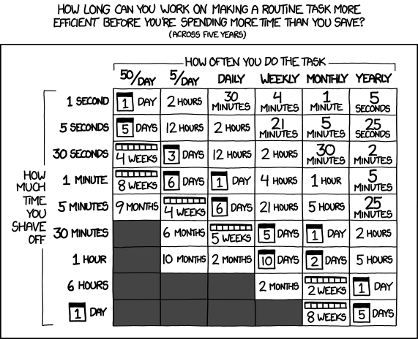
Why Automate? …
Save Time!
Virginia NG911 & GIS User Group Meeting – November 2024

Slide 3
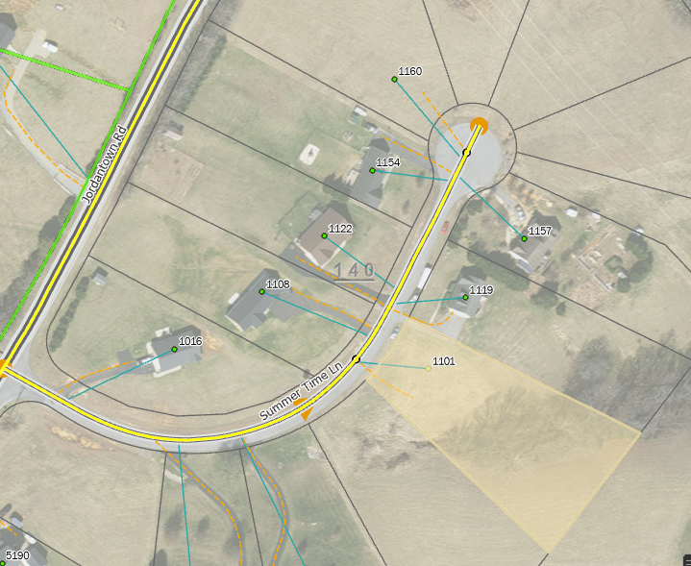
Why Automate?
“Summer Time Ln”
“Summertime Ln”
Save Time!
Minimize Human-Induced Errors — i.e., Typo’s
Virginia NG911 & GIS User Group Meeting – November 2024

Slide 4
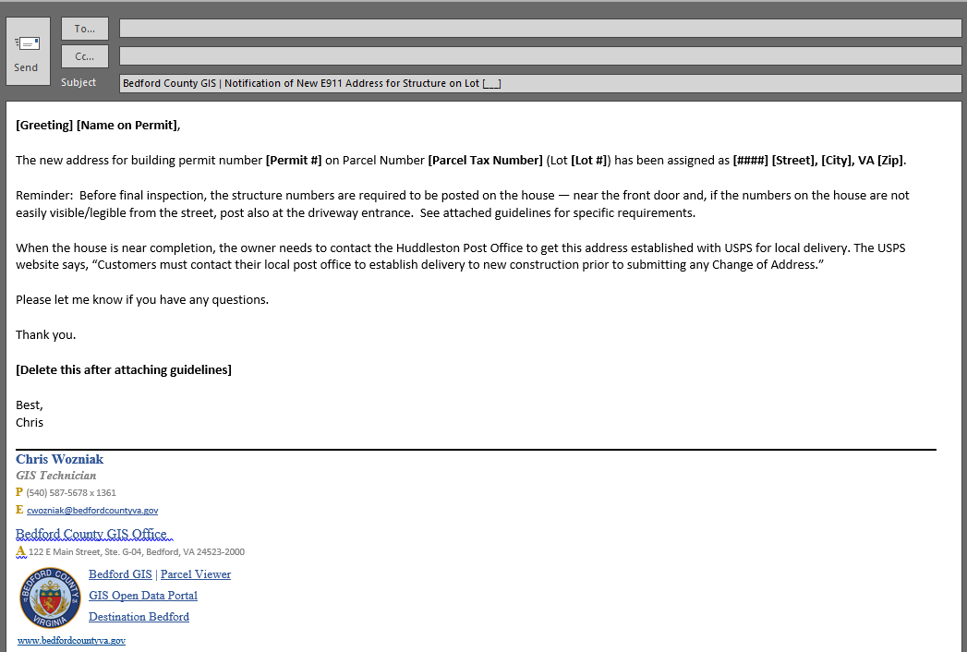



Before – Form Letters (manually fill-in-the-blank’s)
Virginia NG911 & GIS User Group Meeting – November 2024

Slide 5
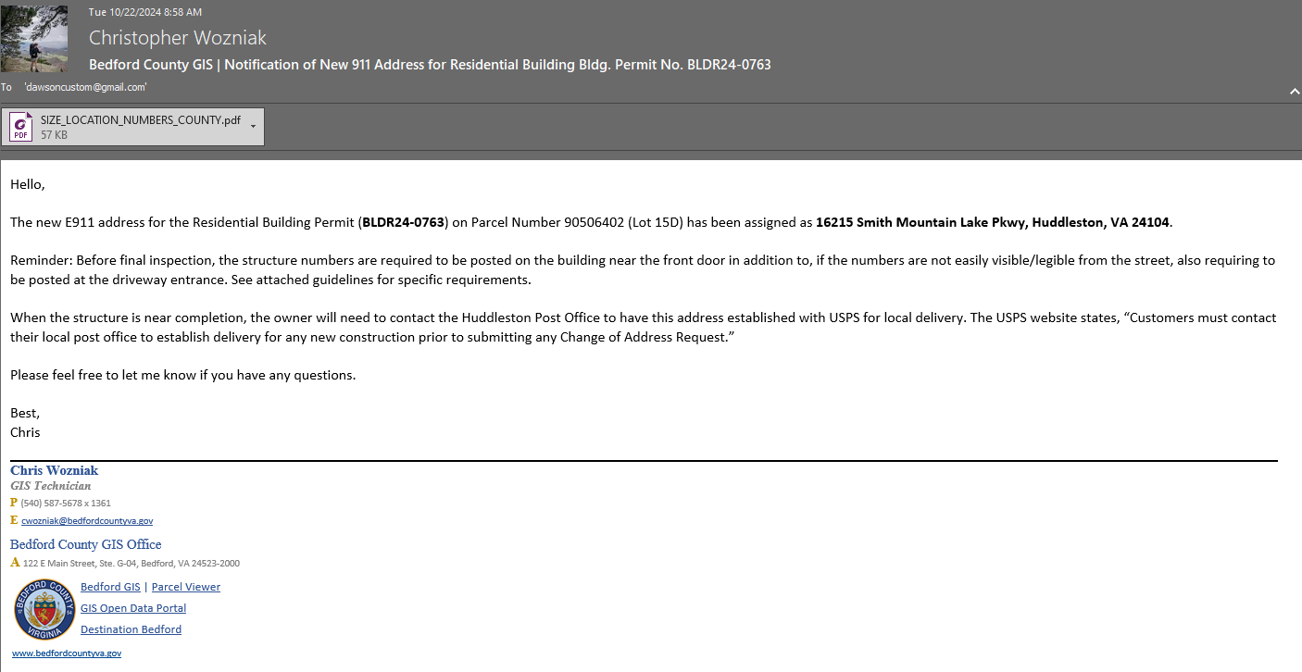
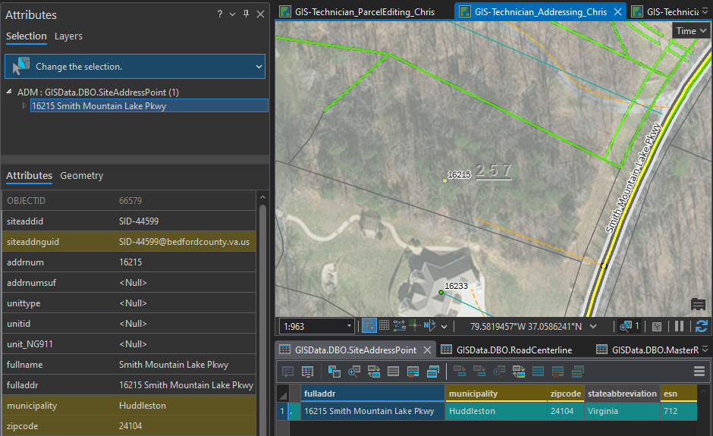
The Idea …
Parcel Feature Class Selection
Virginia NG911 & GIS User Group Meeting – November 2024

Slide 6

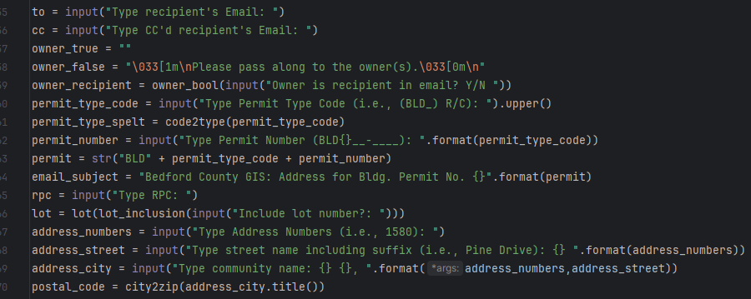
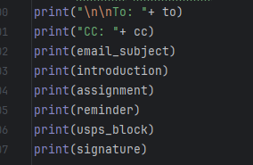
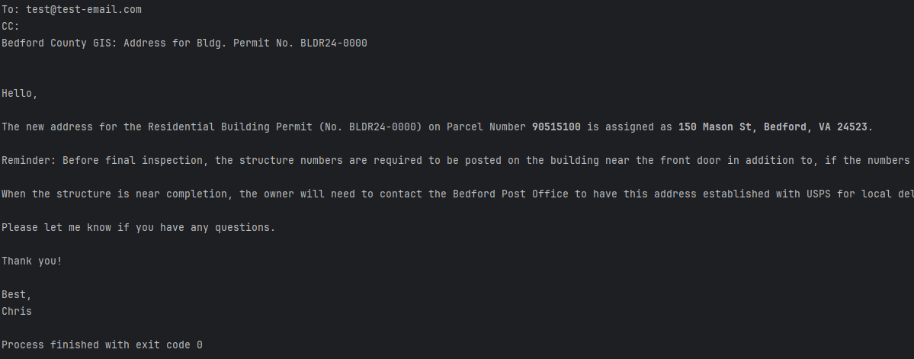
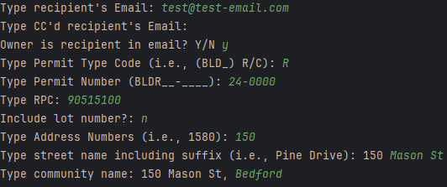
Solution — Python
1
3
2
Virginia NG911 & GIS User Group Meeting – November 2024

Slide 7
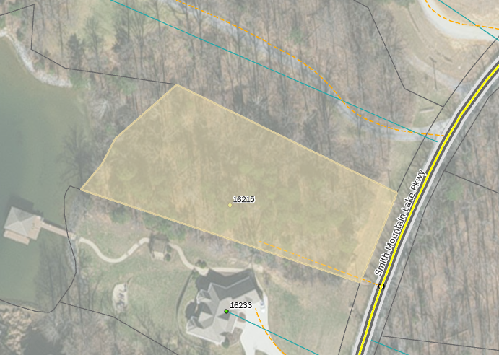
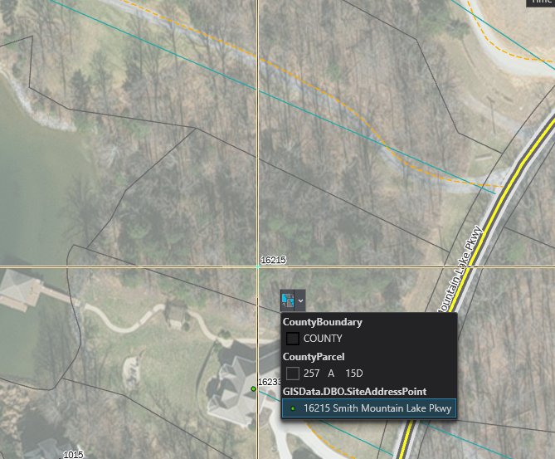
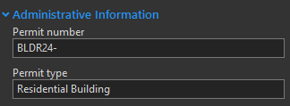

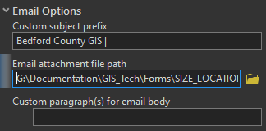
Solution — Geoprocessing Tool
Make the Process “Read” Our data
Same way to “Read” Parcel Data:
Permit Information
Recipient’s Email
Email Options
Virginia NG911 & GIS User Group Meeting – November 2024

Slide 8
Why GP Tool?
Can specify default parameters
  Saves time!
  Ensures accuracy — same way every time
Can do processes entirely within ArcGIS Pro
Virginia NG911 & GIS User Group Meeting – November 2024

Slide 9
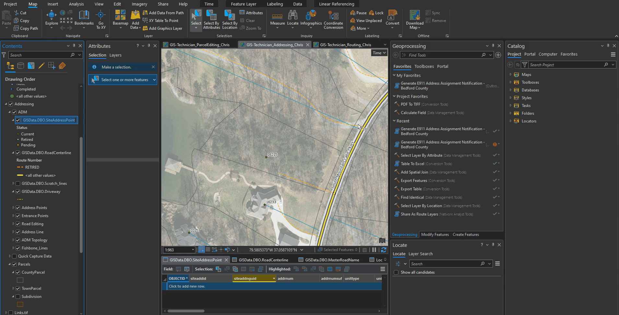
Demo
Virginia NG911 & GIS User Group Meeting – November 2024

Slide 10




Requirements
Any Version*
*3.0 for selection indicator
Newest version might not have library available in package manager.
Reach out to me if you still want to use this tool.
Outlook
ArcGIS Pro
(Python 3.0)
Virginia NG911 & GIS User Group Meeting – November 2024

Slide 11
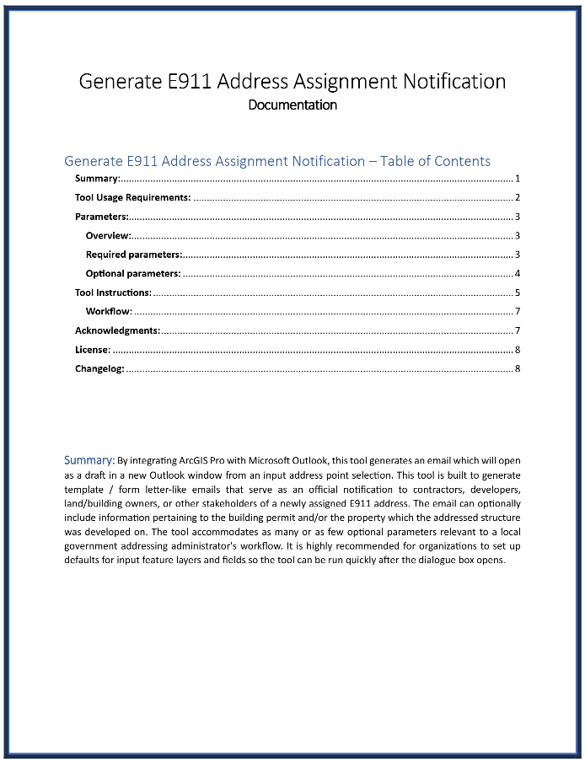
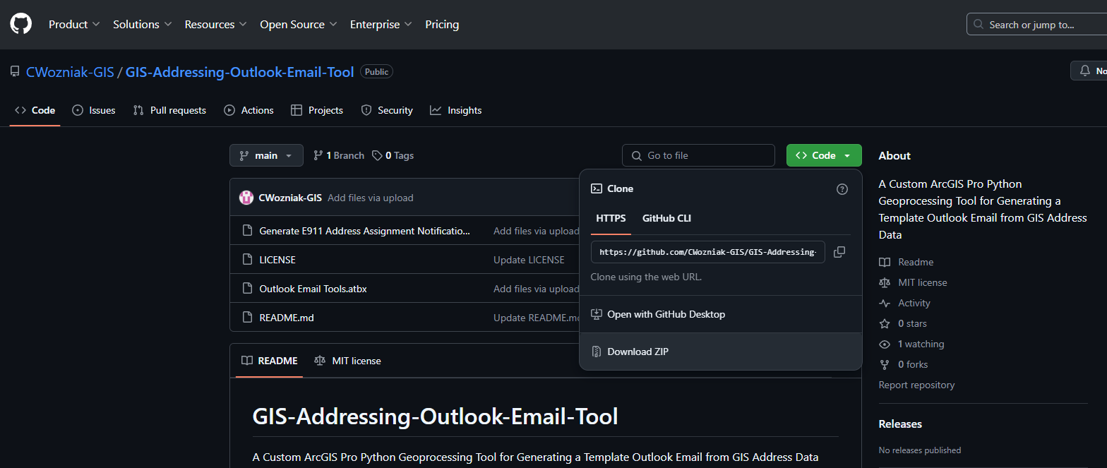
To Download
Virginia NG911 & GIS User Group Meeting – November 2024

Slide 12

Setting Up (Pt 1) …
Custom Library Required: ‘pywin32’
pywin32
arcpy
data
Virginia NG911 & GIS User Group Meeting – November 2024

Slide 13
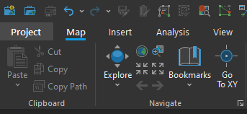
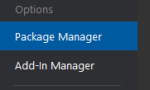
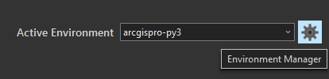
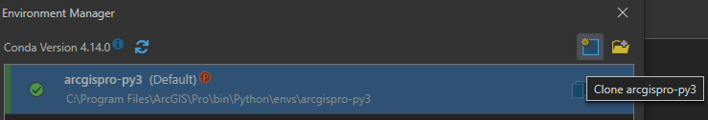
Setting Up (Pt 1) …
Custom Library Required: ‘pywin32’
Need to Clone Base Environment
  Project -> Package Manager ->
  Environment Manager -> Clone
pywin32
arcpy
data
Virginia NG911 & GIS User Group Meeting – November 2024

Slide 14
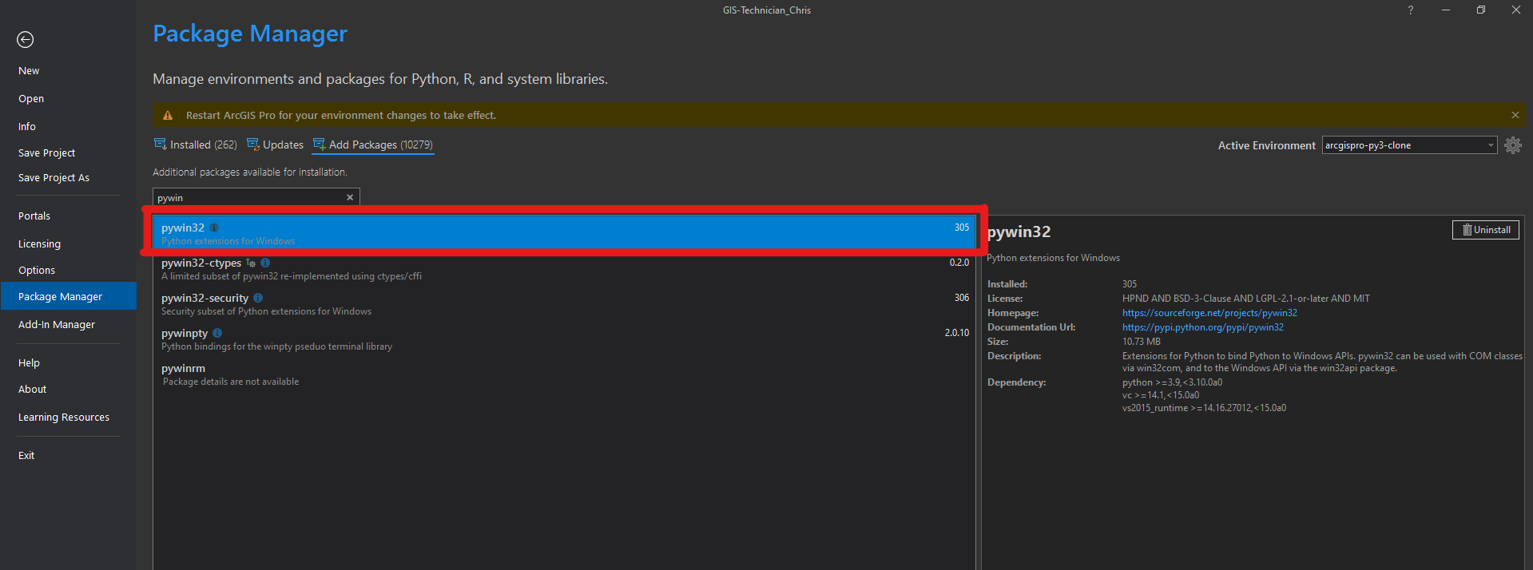

Setting Up (Pt 2) …
Custom Library Required
  Add Packages ->
  ‘pywin32’
If you have any trouble, feel free to reach out to me!
Virginia NG911 & GIS User Group Meeting – November 2024

Slide 15
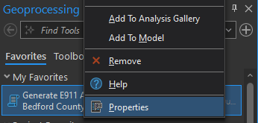
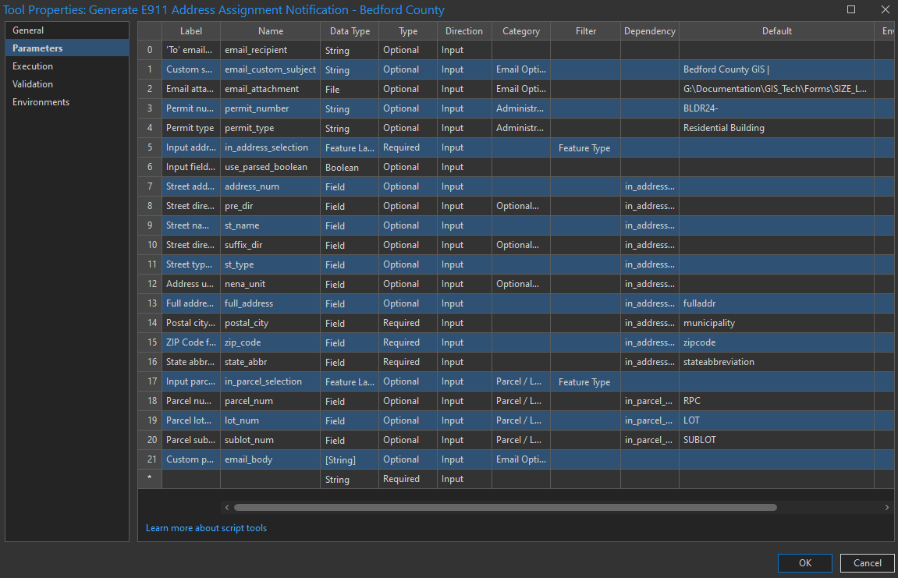

Tips
Set default parameters
Example Included in Toolbox:
  Bedford County’s Default Parameters
Virginia NG911 & GIS User Group Meeting – November 2024

Slide 16
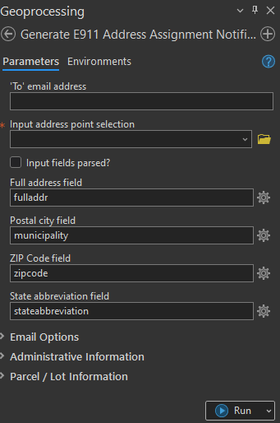
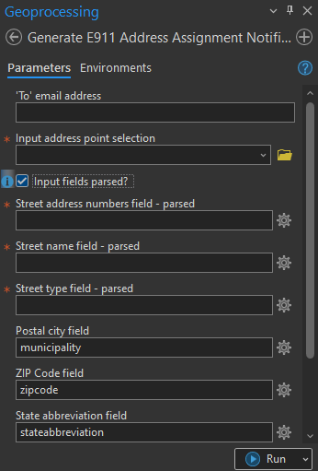
Tips
Set default parameters
Accepts Parsed and Non-Parsed Address Data
Virginia NG911 & GIS User Group Meeting – November 2024

Slide 17



Conclusions
Automate!
  If not to save time, but to ensure data integrity
Virginia NG911 & GIS User Group Meeting – November 2024

Slide 18

Conclusions
Automate!
  If not to save time, but to ensure data integrity
Ask yourself:
  What processes could benefit from automation?
  Repeatable processes, with only a few changing parameters
?
?
Virginia NG911 & GIS User Group Meeting – November 2024

Slide 19




Contact Info
Email me at:
  cwozniak@bedfordcountyva.gov
LinkedIn:
  linkedin.com/in/christopherwozniak1/
Tool:
  github.com/CWozniak-GIS/GIS-Addressing-Outlook-Email-Tool
Virginia NG911 & GIS User Group Meeting – November 2024

